Slide 1
Intro to Single cell RNA sequencing and Scanpy
27th November 24

Slide 2
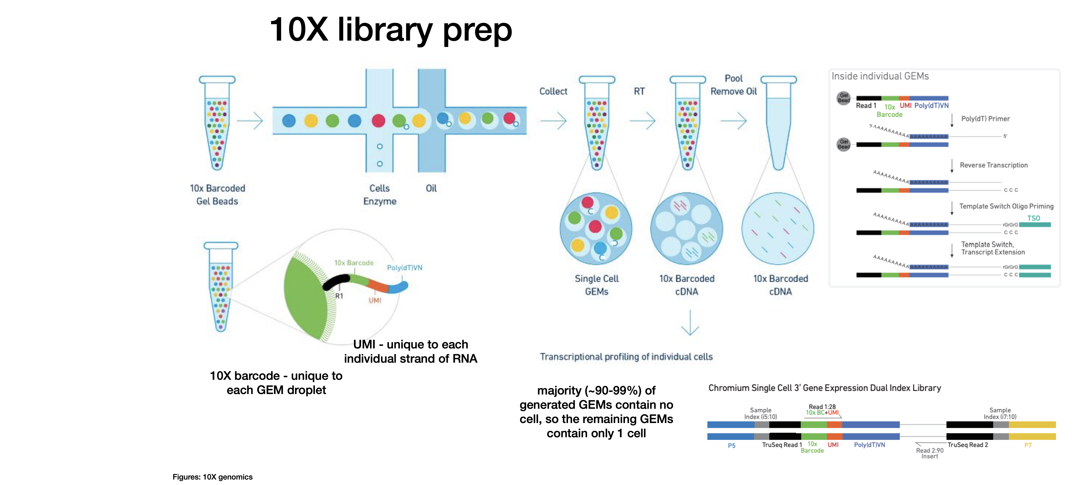
Single cell RNA sequencing
Notes:
What is single cell RNA sequencing? Or single cell transcriptomics
Its RNA sequencing at single cell resolution
Essentially sequencing all of the mRNAs within a cell so we can see what genes a cell is expressing.
How can we do this?
First Isolating the individual cells, mainly done in droplet based system,
Gel bead is coated with primers, a barcode which is unique to each bead, a UMI, and a polydT primer,
The cells are lysed in the droplet
polyT primers which bind to the polyA tail of the mRNA in the droplet,
Individual cells are barcoded, and then pooled to end up with a massively multiplexed library

Slide 3
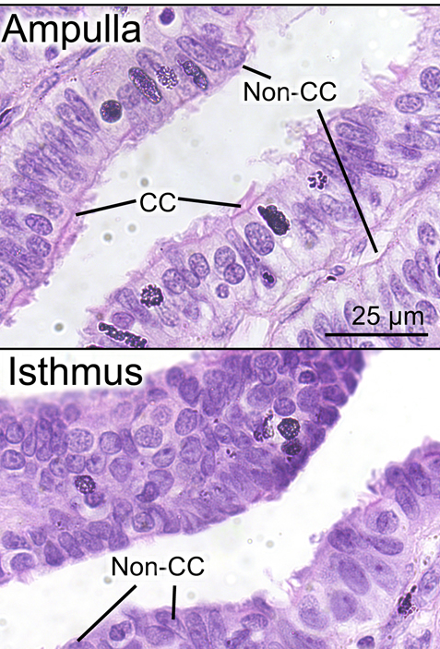
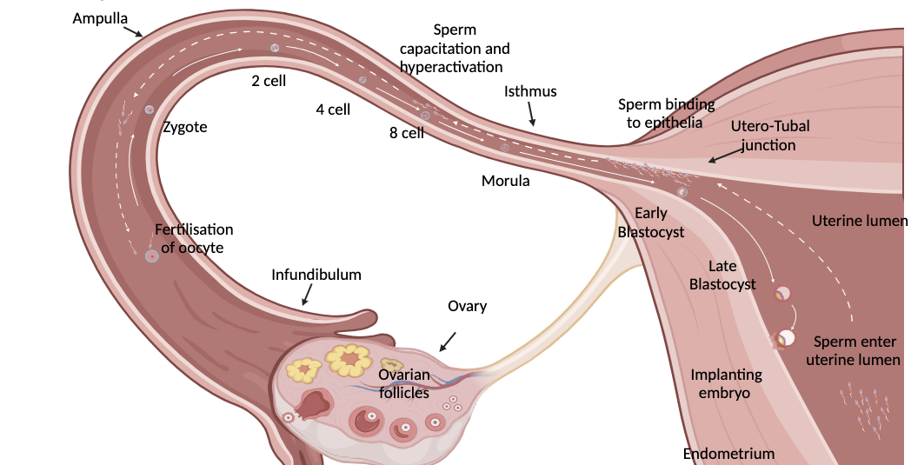
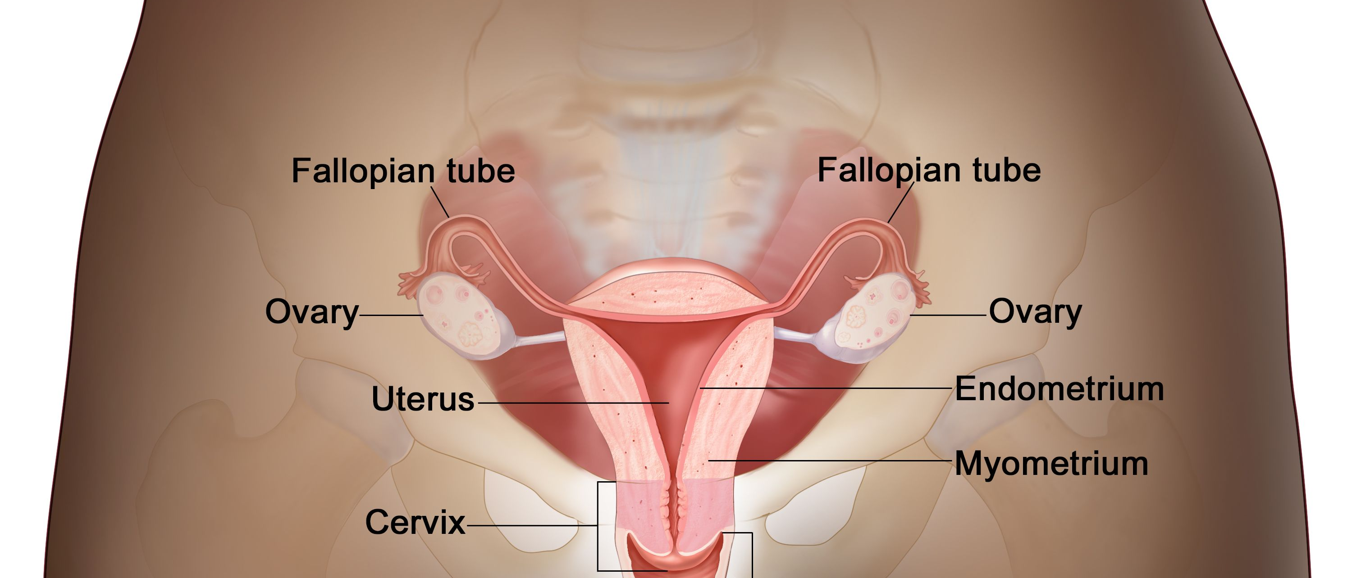
Single cell RNA sequencing – Fallopian tube example
Fallopian tube epithelium – Simple columnar epithelium
CC – Ciliated epithelial cell
Non-CC - Non ciliated epithelial cell, or secretory epithelial cell
Notes:
A detour to the fallopian tube, as this is going to be the subject of the coding exercises we’ll be doing next week
The fallopian tube is the connection between the ovary and the uterus
I’m interested in the fallopian tube because its an underresearched organ,
Lots of critical steps in early reproduction happen here but we don’t understand what the fallopian tube necessarily does.
Thin smooth muscle layer, a bit of stromal cells, and then the epithelium
Two types of cells make up the epithelium
Ciliated and secretory
Image sources:
https://www.cancer.gov/publications/dictionaries/cancer-terms/def/fallopian-tube
winuthayanon et al. 2020, Roles of steroid hormones in oviductal function https://doi.org/10.1530/rep-19-0189

Slide 4
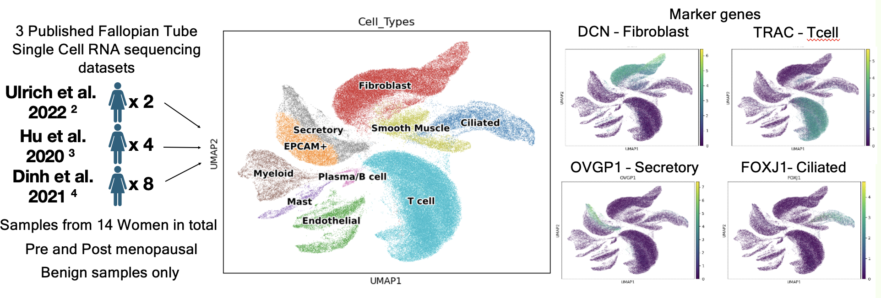
Single cell RNA sequencing – Fallopian tube example
Each data point = 1 cell
UMAP plots cells based on their gene expression
Clustering analysis identifies groups of cells with similar gene expression
Can be used to identify classical cell types
Notes:
Past ScRNA seq analysis of fallopian tube
what is a umap? For each cell we have recorded the expression level of around 20,000 genes, we have 20,000 variables, so we can’t use an Xy axis as this would only account for 2 variables,
Have to perform a dimensionality reduction to plot all the variables and cells as data points,
UMAP helps to plot all the variables into a 2D visualization
Each point represents 1 cell, plotted based on their gene expression
Cells closer together have more similar gene expression, and those further apart have different gene expression
We can also perform clustering analysis of our data, this identifies groups of cells with similar gene expression
If we have groups of cells with similar gene expression this can be used to first identify classical cell types, so here you can see we have this clusters of cells,
We can plot the gene expression for known marker genes so T receptor alpha, highlights this one cluster, this is likely a group of T cells etc…

Slide 5
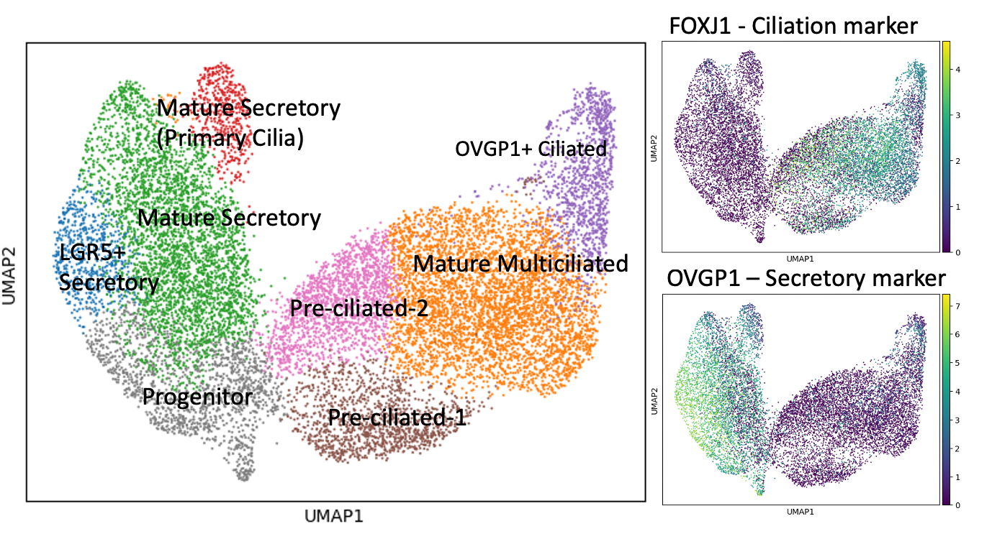
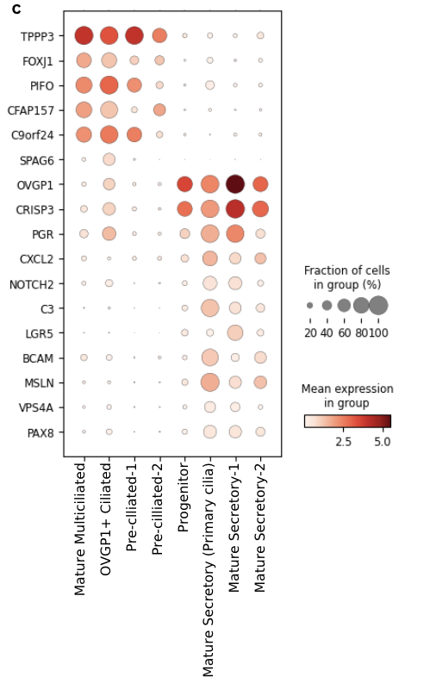
Clustering analysis identifies groups of cells with similar gene expression
Clustering analysis can be performed sequentially to identify heterogeneity within cell types
Fallopian Tube epithelial cells
Notes:
One benefit of using single cell RNA sequencing over bulk tissue RNA sequencing is that we can identify cell types,
But we can also look at heterogeneity of gene expression within cell types by doing further clustering analyses,
Here we’ve taken just the ciliated and secretory cells,
To ask whether there are differences in gene expression between epithelial cell, and we identify clusters which may represent sub populations of cells

Slide 6
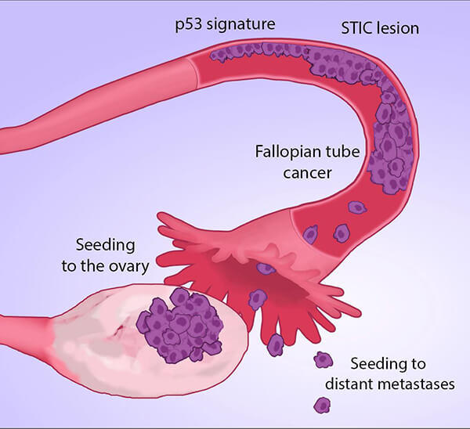
Single cell RNA sequencing – Fallopian tube and High Grade Ovarian Carcinoma
HGOC is thought to originate from the fallopian tube epithelium in many cases
5 x Benign FT samples
5 x FT samples from women with HGOC
We can examine the fallopian tube epithelial cells in samples from 5 women with HGOC, and compare them to fallopian tube epithelial cells from healthy controls.
Are STIC lesions present?
Are they present in all patients?
Do the secretory epithelial cells have similar gene expression in the HGSOC and control samples?
What about the ciliated cells do these look similar between control and HGOC patients?
STIC lesion – serous tubal intra-epithelial carcinoma
Notes:
One of the contexts we can investigate the fallopian tube using single cell RNA sequencing effectively is in the context of ovarian cancer,
So ovarian cancer is one of the most common gynaecological cancers, and high grade ovarian carcinoma, is a cancer of the epithelium, and has poor outcomes as it is often identified late,
There is one theory that HGOC is thought to originate in the fallopian tube in many cases,
So here we have 5 women with HGOC, and we’ve performed scRNAseq on samples of their fallopian tube, and we want to examine the cells types in their fallopian tube epithelium
Compare this to our 5 healthy control FT samples
Are they different?
Image from: https://www.cancer.gov/news-events/cancer-currents-blog/2017/ovarian-cancer-fallopian-tube-origins

Slide 7
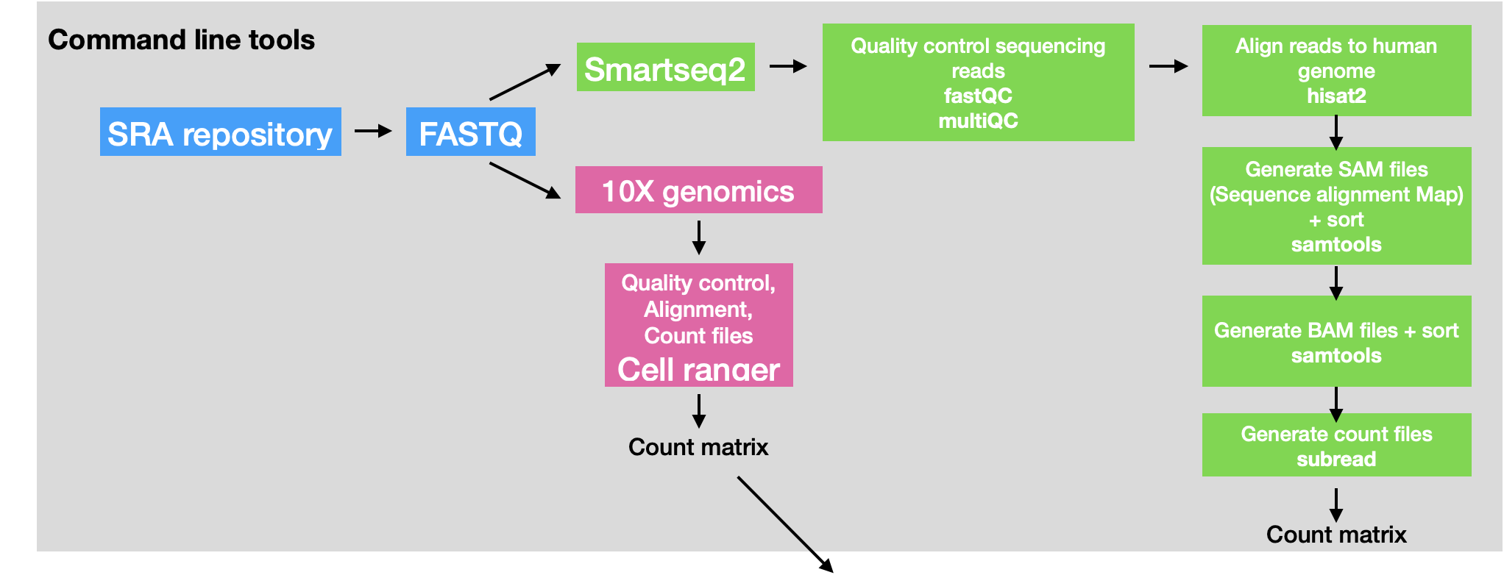
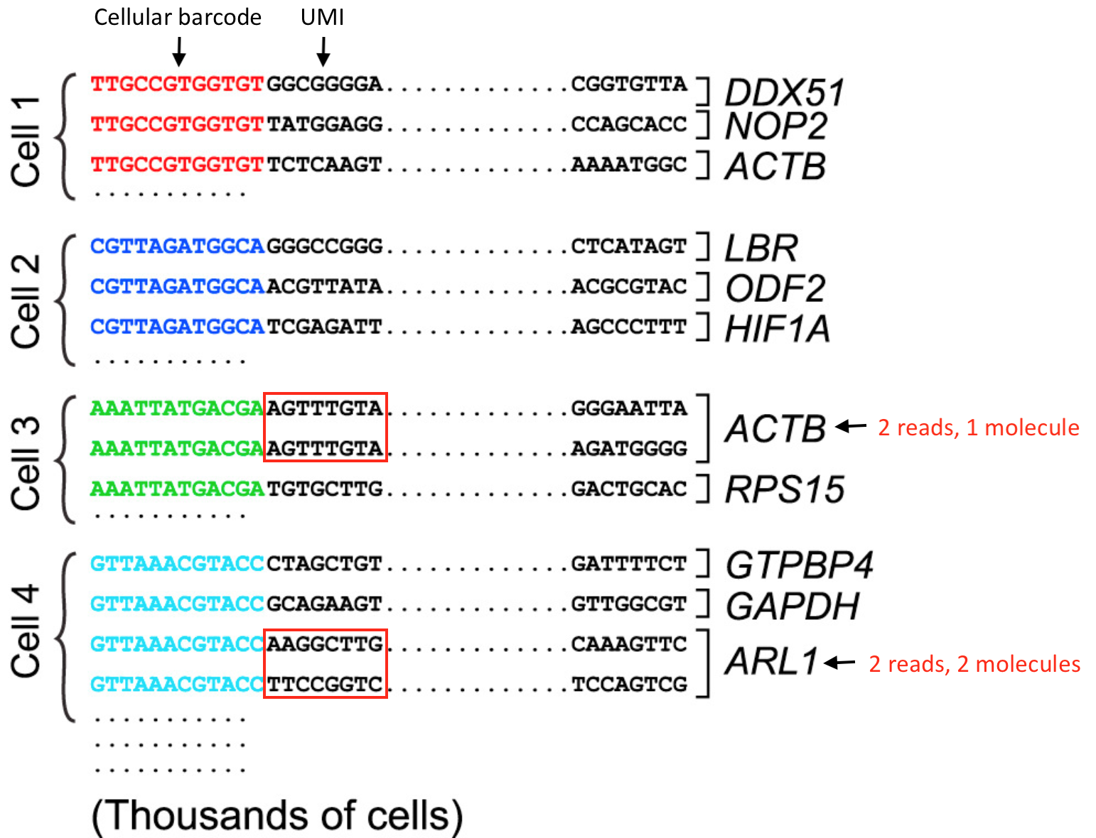
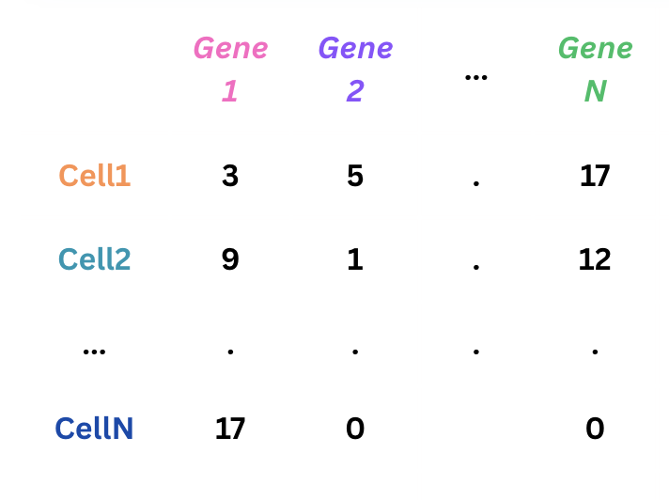
Single cell RNA sequencing data processing and analysis
Count matrix
Notes:
Data format we use for single cell RNA seq data is a count matrix
Derived from the basis that barcodes are representing an individual cell, and the UMIs are representing a molecule of mRNA, and in turn one count of gene expression
Count matrix figures: Lafzi et al. Tutorial: guidelines for the experimental design of single-cell RNA sequencing studies, Nature Protocols 2018 (https://doi.org/10.1038/s41596-018-0073-y)

Slide 8
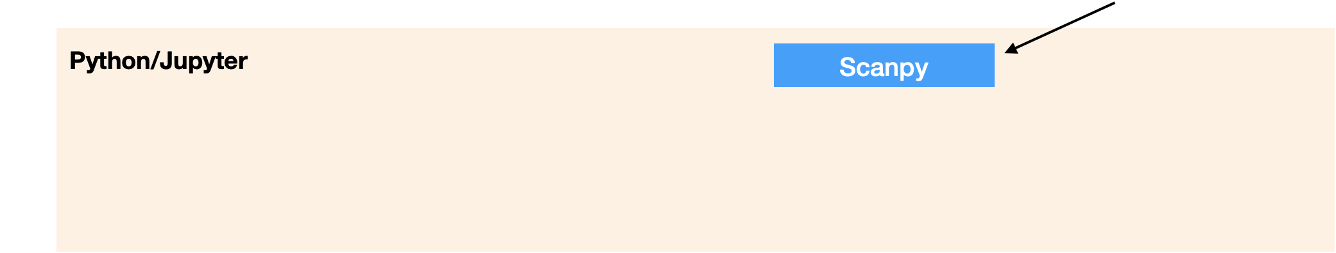
Single cell RNA sequencing data processing and analysis

Slide 9
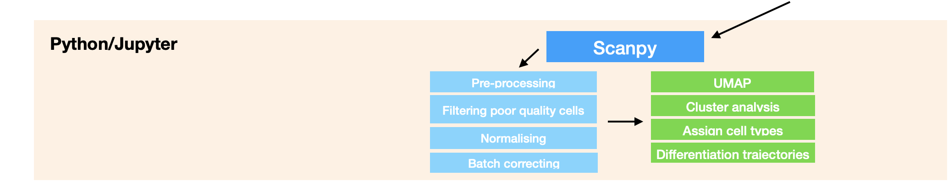
Single cell RNA sequencing data processing and analysis

Slide 10
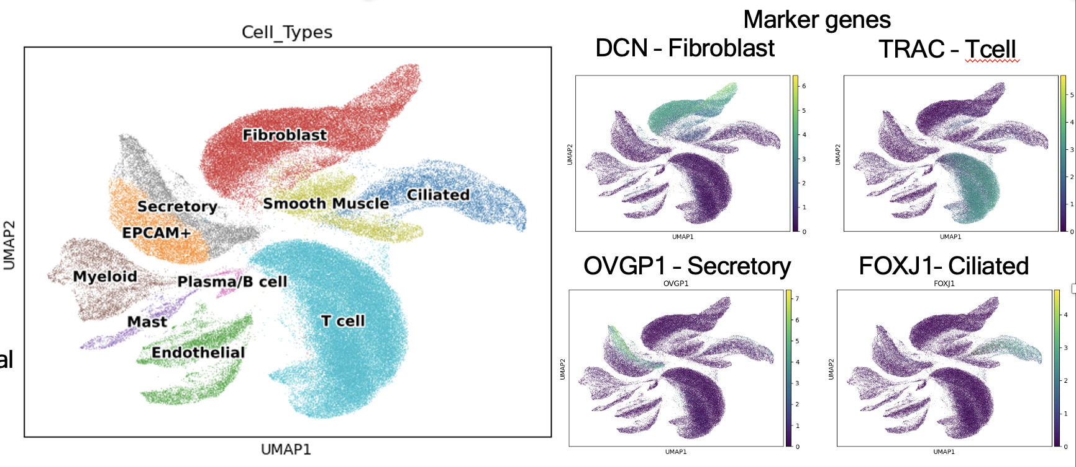
Scanpy
Scalable toolkit for analyzing single-cell gene expression data
Contains all the functions required to get from a count matrix to an annotated UMAP, and plot further visualizations
Count matrix

Slide 11

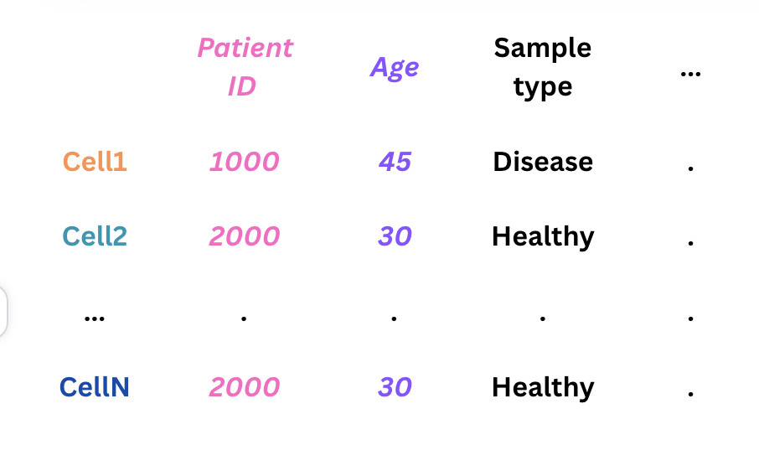
Single Cell Analysis in Python
Built jointly with Anndata (package for handling annotated data matrices)
Anndata integrates count matrix with Metadata, and stores extra information you generate throughout the analysis, eg. Highly variable genes, coordinates for graphs
Count matrix
Metadata
Notes:
Built with anndata, similar to pandas, in that its dataframe structures, but allows the dataframes to be connected, similar to the 3D data matrix

Slide 12
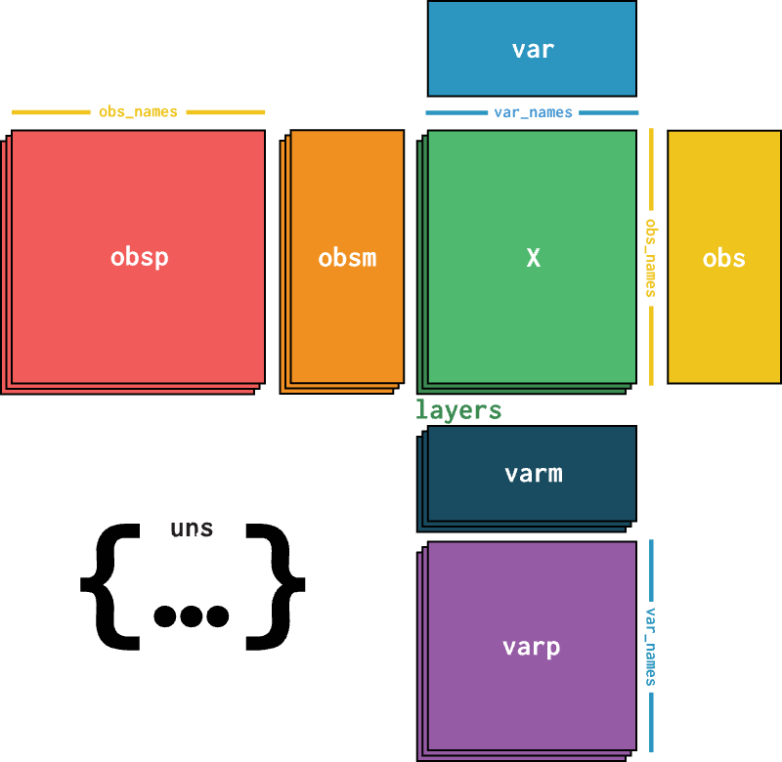
AnnData
Metadata/Obs
Notes:
Ann data is one data object,
Allows tables to be joined together on a common index, so we have the count matrix, and we just have query different tables within the object, and here they are all indexed on the cell ID

Slide 13
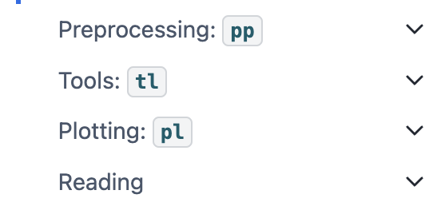
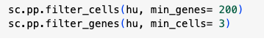
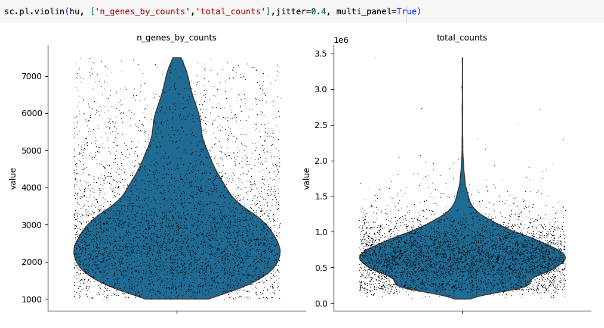
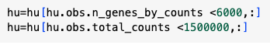
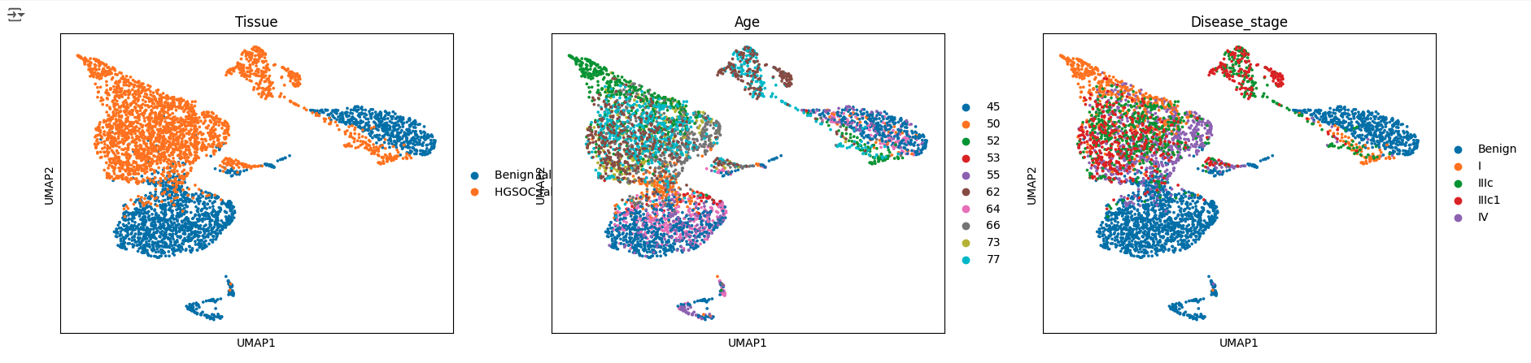
Scanpy
Main objectives
Preprocessing
Dimensionality reduction and Clustering
Plotting/visualizations

Slide 14
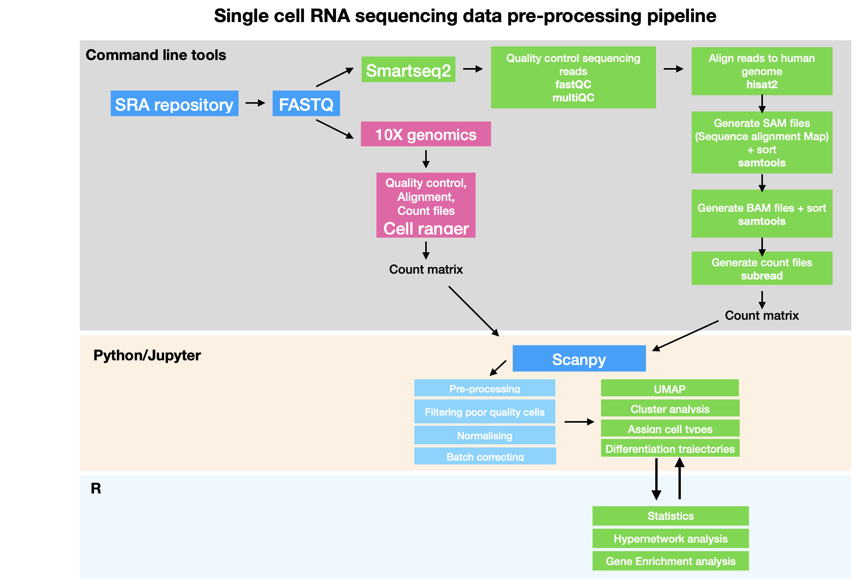
Single cell RNA sequencing data processing and analysis

